Slide 1
The boss code
Keresztúri Péter
Github - Plonee

Slide 2

Quick recap
The feeling of accomplishment
Getting more confident
To be the very best, like no1 ever was

Slide 3
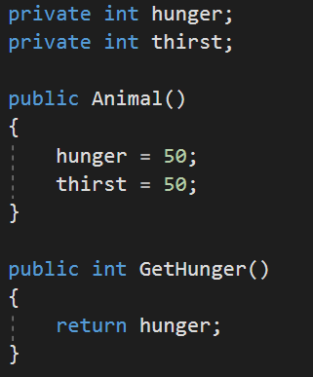
Classes
Main can’t access it
Default values
Call this in Main

Slide 4
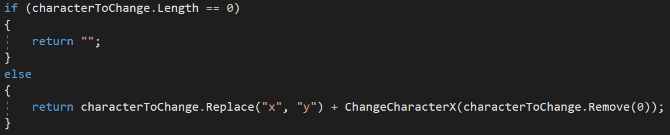
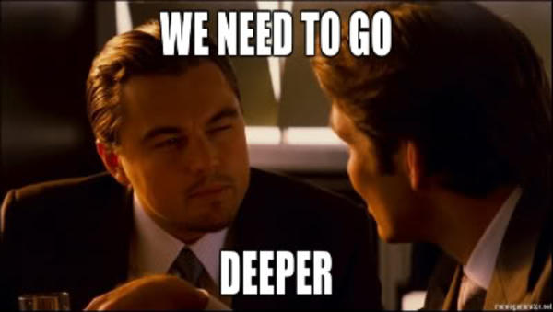
REcursion
Methodception

Slide 5

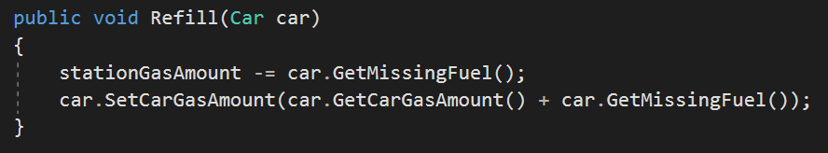
Gas Station
Create object

Slide 6
Aims and goals for next week
Pirates
Practice
Search moar
Debug moar

Slide 7
Thank you!
Cső Alex!

